Slide 1
Final Exam
CIS 122
Professor Payal Shete
Hu

Slide 2

Whole Process
Image1
Image2
F1OUT.JPG
Part1
Part2
subFn1
subFn1
F2OUT.JPG
SubFn2
subFn2
F2OUT.JPG
SubFn3
subFn3
SubFn4
subFn4

Slide 3
Part1
mainFn()
def mainFn(path):
global p1,p2
global w1,h1,w2,h2
global canvas1
global wc1,hc1
p1=makePicture(pickAFile())
w1,h1=getWidth(p1),getHeight(p1)
p2=makePicture(pickAFile())
w2,h2=getWidth(p2),getHeight(p2)
canvas1=makeEmptyPicture(w1+w2+5,h1+h2+5,green)
wc1,hc1=getWidth(canvas1),getHeight(canvas1)
Image1
Image2
Using global varieties to save steps
Part1
subFn1
SubFn2
SubFn3
SubFn4
F1OUT.JPG

Slide 4
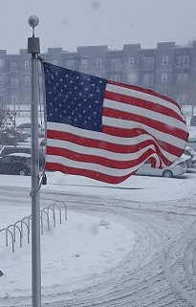
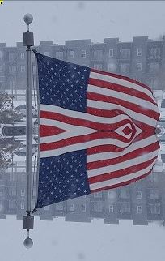
Part1
subFn1
mirroring pixels
mirrorpoint=h1/2 #set mirrorpoint
for x in range(0,w1): #choose original x range
for y in range(0,mirrorpoint): #choose original y range
topPX=getPixel(pic1,x,y) #set the start point of the copied pixels
bottomPX=getPixel(pic1,x,h1-y-1) #set the destination of the copied pixels
colorP=getColor(topPX) #copy color from original pixels
setColor(bottomPX,colorP) #set color to the destination
Image1
Image2
Part1
subFn1
SubFn2
SubFn3
SubFn4
subFn1
F1OUT.JPG

Slide 5
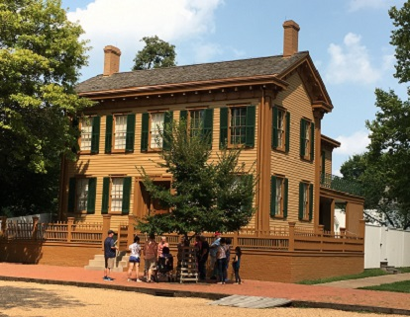
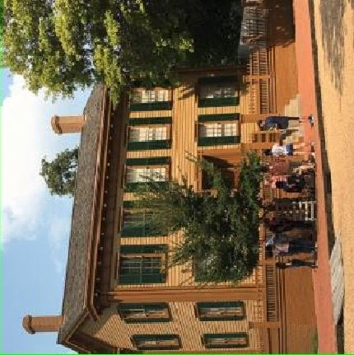
Part1
rotating an image
SubFn2
targetX=0 #set start point on the canvas
for picX in range(0,w2): #loop the X value
targetY=0 #set start ponit on the canvas
for picY in range(0,h2): #loop the Y value
colorC=getColor(getPixel(pic2,picX,picY)) #copy pixels from the picture
setColor(getPixel(pic2r,targetY,targetX),colorC) #write pixels to the canvas
targetY=targetY+1 #move to next Y value
targetX=targetX+1 #move to next X value
Image1
Image2
Part1
subFn1
SubFn2
SubFn3
SubFn2
SubFn4
F1OUT.JPG

Slide 6
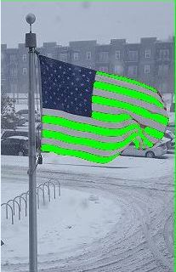
Part1
SubFn3
Changing Color
#red eye reduction algorithm #resource: https://stackoverflow.com/questions/133675/red-eye-reduction-algorithm
gbaverage=(float(g)+float(b))/2
reddect=(float(r))/gbaverage
if picX>44 and picX<200: #choose x range
if picY>63 and picY<200: #choose Y range
if float(reddect)>1.4: #detect red color
setColor(px,green) #change color to green
Image1
Image2
Part1
subFn1
SubFn2
SubFn3
SubFn4
SubFn3
F1OUT.JPG

Slide 7
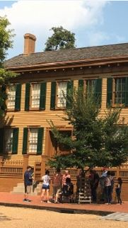
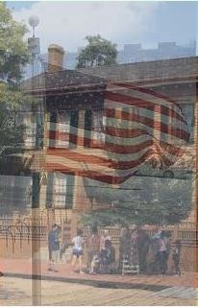
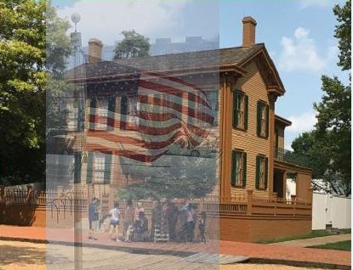
Part1
SubFn4
Blending images
Step1
Step2
Step3
Image1
Image2
Part1
subFn1
SubFn2
SubFn3
SubFn4
F1OUT.JPG

Slide 8
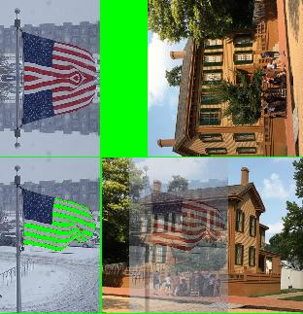
Part1
F1OUT.JPG
subFn1
subFn2
Image1
Image2
Part1
subFn1
SubFn2
SubFn3
SubFn4
SubFn3
SubFn4
F1OUT.JPG

Slide 9
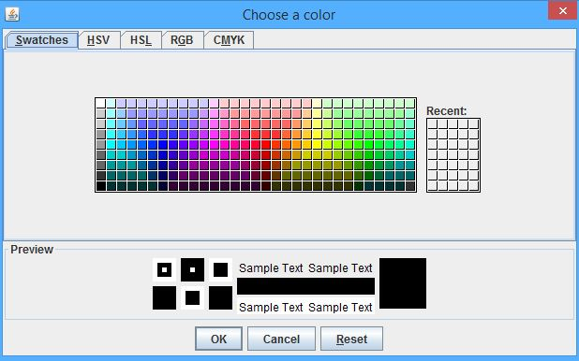
Part2
mainFn()
global f1
global widthf1,heightf1
global canvas2
global widthc,heightc
f1=makePicture(pickAFile())
widthf1,heightf1=getWidth(f1),getHeight(f1)
cc=pickAColor()
widthc,heightc=3*widthf1,3*heightf1
canvas2=makeEmptyPicture(widthc,heightc,cc)
F1OUT.JPG
Part2
subFn1
subFn2
subFn3
subFn4
F2OUT.JPG

Slide 10
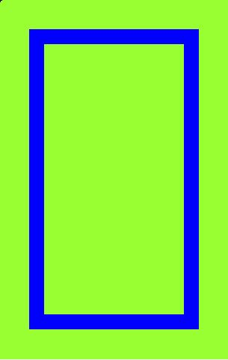
Part2
subFn1
Using classes
t.penDown()
t.drawhor() #use the subclass draw a horizontal line
t.drawver() #use the subclass draw a vertical line
t.drawhor() #use the subclass draw a horizontal line
t.drawver() #use the subclass draw a vertical line
F1OUT.JPG
Part2
class draw(Turtle): #define the mainClass
def drawhor(self): #define the subclass to draw a horzontal line
for i in range(1):
self.turn(90)
self.forward(widthc-200)
def drawver(self): #define the subcalss to draw a vertical line
for i in range(1):
self.turn(90)
self.forward(heightc-200)
subFn1
subFn2
subFn3
subFn4
F2OUT.JPG

Slide 11
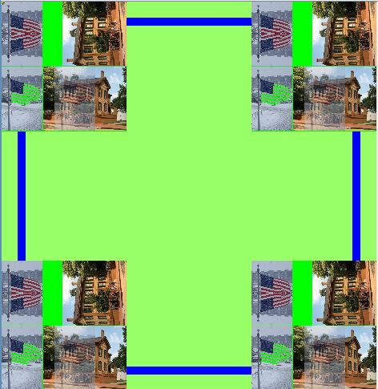
Part2
subFn2
Copying F1OUT.JPG to each corner
F1OUT.JPG
Part2
subFn1
subFn2
subFn3
subFn4
F2OUT.JPG

Slide 12
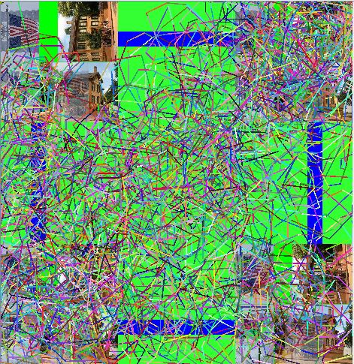
Part2
subfn3
Radom drawing
def subFn3(): #draw randomly on canvas
tr=Turtle(canvas2)
tr.setPenWidth(3)
for i in range(6000):
tr.setPenColor(makeColor(random.randint(1,255),random.randint(1,255),random.randint(1,255)))
tr.forward(int(100*random.random()))
tr.turn(int(90*random.random()))
F1OUT.JPG
Part2
subFn1
subFn2
subFn3
subFn4
F2OUT.JPG

Slide 13
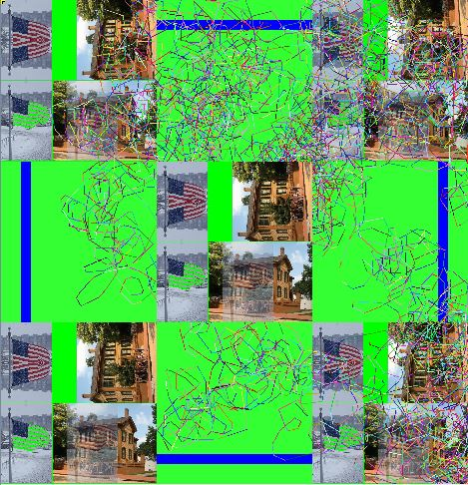
Part2
subFn4
Copying F1OUT.JPG to the center
F2OUT.JPG
F1OUT.JPG
Part2
subFn1
subFn2
subFn3
subFn4
F2OUT.JPG

Slide 14
Thank You

